Slide 1
MEMBER RESOURCES
PROTECTING YOUR PIECE OF OREGON
Notes:
Notes/Talking Points:
An overview of member resources, discounts and other benefits available to OAR members

Slide 2
MEMBER RESOURCES
MISSION & VISION
Our mission is to unify and serve our members and local associations by providing the resources and tools for their success.
Our vision is to be the trusted source for all things real estate in Oregon.
Notes:
Notes/Talking Points:
Providing these resources is a cornerstone of OAR’s mission and vision

Slide 3
MEMBER RESOURCES
Business Toolkits
> Buyer/Seller Advisories
> Flood Insurance Toolkit
> DCMA Toolkit
> Risk Management Toolkit
Notes:
Notes/Talking Points:
Buyer/Seller Advisories
Helps determine property conditions & value
Available in most languages
Accessible on the OAR website
Shareable from your website or email
Flood Insurance Toolkit
Documents, links & videos on flood insurance topics
DCMA Toolkit
Protection from copyright infringement liability
Sample languages & forms
Website compliance with “Safe Harbor” provisions
Risk Management Toolkit
Comprehensive reference guide to real estate transactions
Access on the OAR website with NRDS number & password

Slide 4
MEMBER RESOURCES
Member Directory
Mobile Safety App
Housing Market Data
Notes:
Notes/Talking Points:
Member Directory
An online in a directory of 16,600+ members
Find REALTORS® in other local markets for referrals
Build your network
Access from the OAR website with NRDS number & password
Mobile Safety App
Transforms mobile devices into personal emergency phones
Provides two-way communication with 911 authorities, private security, and safety groups
Discounted price for OAR members ($17.99 per year)
Contact www.guardly.com/
Housing Market Data
Member access to Realtors Property Resource (RPR)
Monthly updates of key metrics on OAR website

Slide 5
MEMBER RESOURCES
Member Discounts
> Transaction Forms
> E&O Insurance
> Office Supplies
Notes:
Notes/Talking Points:
Transaction Forms
Access to the Oregon Real Estate Forms library
Save $100 as an OAR member
Go to www.orefonline.com or call 503-459-0195
E&O Insurance
Access to quality Errors & Omissions (E&O) insurance through a trusted partner
Access to risk management tools & services, plus proactive claims handling
Call 800-447-4982 for a quote
Office Supplies
Member discounts (typ. 10%) on 175+ items from Office Depot/OfficeMax, including copy & print center
Tiered discounts & FREE next-day delivery on most products
Shop online or at retail locations
Member discounts on breakroom products & office furniture
Go to Member Benefits section of OAR website for details

Slide 6
MEMBER RESOURCES
Member Discounts
> Group Insurance
> Tech Helpline
> Columbia Sportswear Employee Store
> Risk Management Toolkit
Notes:
Notes/Talking Points:
Group Insurance
Group insurance rates on a full suite of policies, including medical, life & auto through Johnson Benefit Group, Inc.
Group insurance rates on dental insurance from Willamette Dental Group
Go to Member Benefits section of OAR website for details
Tech Helpline
FREE access to technology “geeks” for 500,000+ hardware, software & networking products
Available M-F, 6am – 5pm PT & Saturday, 6am – 2pm PT
Call 1-888-804-8226 or email support@techhelpline.com
Columbia Sportswear Employee Store in Portland
Exclusive access to employee pricing
EVERY Wednesday, 10am – 7pm
For OAR members and up to four (4) guests
REALTOR® Team Store
10% discount on product/publication purchases
Go to https://store.realtor.org/ & use promo code OAR2

Slide 7
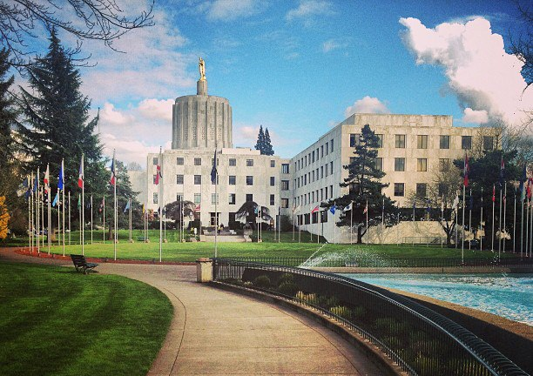
MEMBER RESOURCES
Advocacy
> Government Affairs
> Political Affairs
> RPAC
> Issues Mobilization
> Calls for Action
Notes:
Notes/Talking Points:
Government & Political Affairs
Dedicated OAR staff
Key Committees of member volunteers & leadership
RPAC
Funding for national, state & local political campaigns
Portion of your annual membership dues (max. $50/year); 35% returned to local association/board
Major Investor voluntary contribution (min. $1,000/year)
Recognition (pin) for voluntary contributions beginning at $50
Issues Mobilization
Funding & services for local ballot measure campaigns
Available to individual embers or local associations/boards
Application & approval process
Funded by a percentage of annual membership dues
Calls for Action
Online support/opposition of national, state or local issues
“The Voice of the REALTOR®” in government decisions
Register & respond via VoterVoice email platform

Slide 8
MEMBER RESOURCES
Risk Management
> Legal Hotline
> Legal Hotline Q&A Archives
> Mediation & Arbitration
Services
Notes:
Notes/Talking Points:
Legal Hotline
Access to specialized real estate attorneys for all your transaction questions
Responses given within 24 hour
$125 annually for unlimited questions via phone or email
Call: M-F, 9am – Noon (except holidays)
Email: M-F, 8am – 5pm PT (except holidays)
Subscribe online or call 800-252-9115
Legal Hotline Q&A Archives
FREE online selection from Legal Hotline calls & emails
Access on the OAR website with your NRDS number & password
Mediation & Arbitration Services
Mediation & arbitration services from a trusted partner
Specialists in resolving real estate transaction disputes
Call 800-423-1216 for information

Slide 9
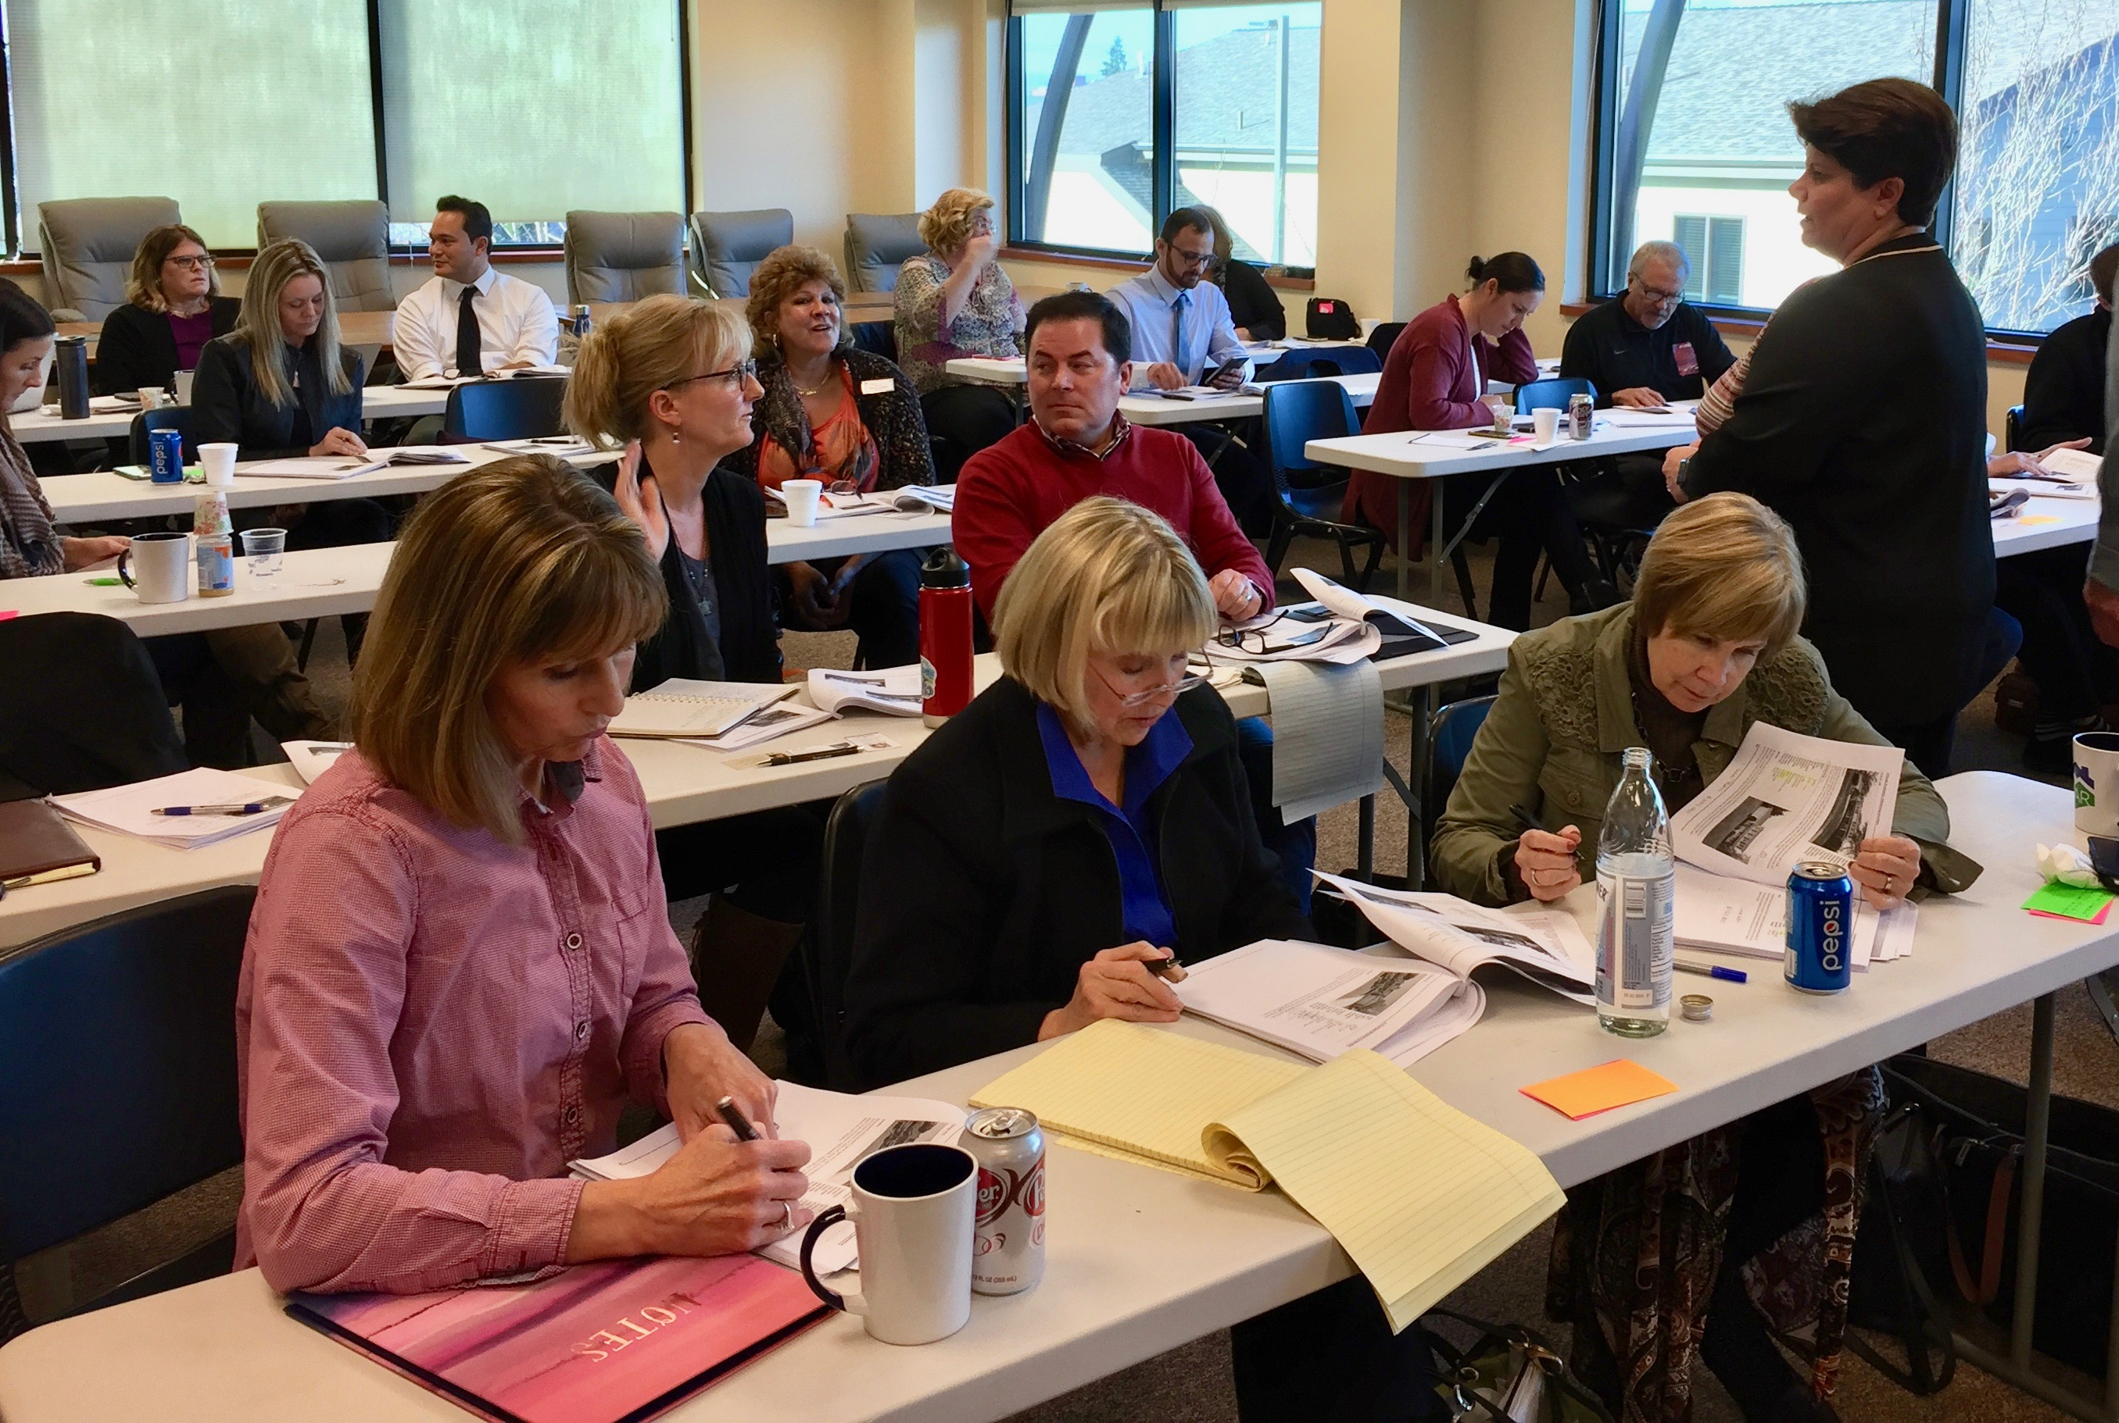
MEMBER RESOURCES
Professional Development
> Live Coursework
> Online Learning
Notes:
Notes/Talking Points:
Live Coursework
Member pricing for live coursework, including GRI and other NAR designations & certifications
46 GRI courses scheduled in 13 locations statewide in 2018
Four NAR designation/certification classes in 2018
Go to our online Education portal for info & to register
Online Learning
Member discounts for online learning platforms at InteractCE and the CE Shop
20+ live webinars scheduled in 2018
Allows multiple attendees for CE credit per purchase
Webinars recorded and available online: Absorb LMS platform: $10 each, CE credits apply
Go to our online Education portal for info & to register

Slide 10
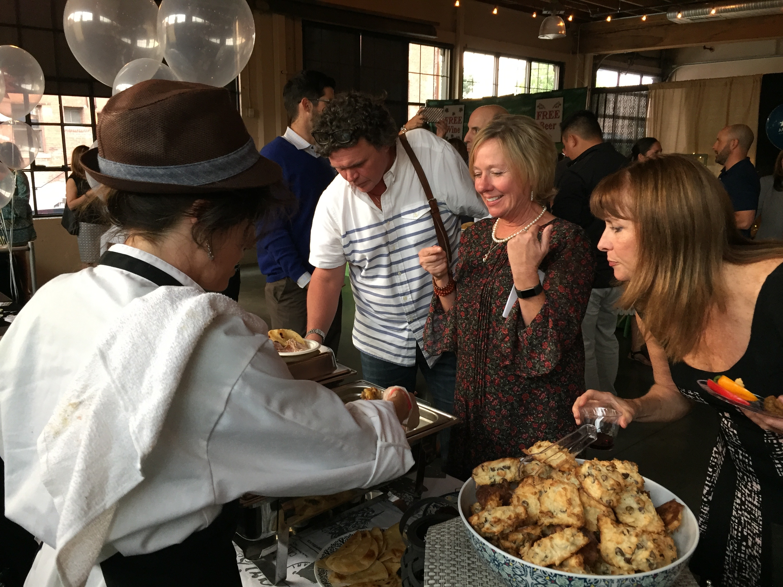
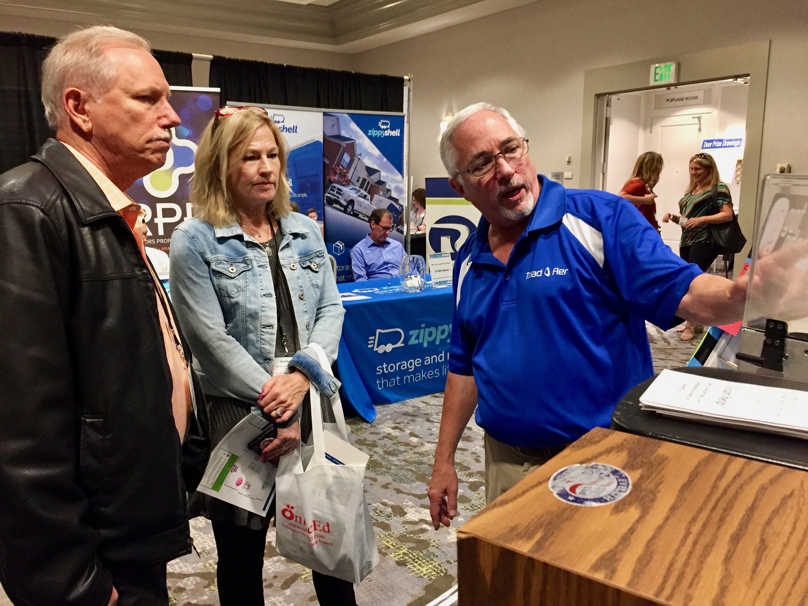
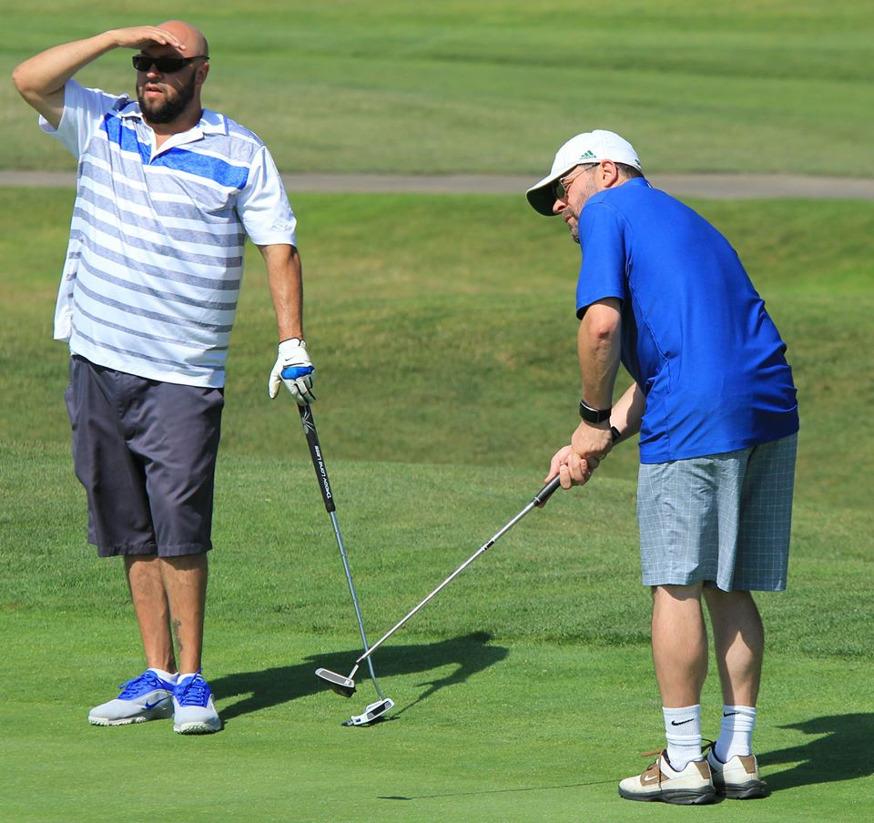
MEMBER RESOURCES
Member Engagement
REALTOR® Day at the Capitol
> In Person
Leadership Training
Spring & Fall Governance Meetings
Fall Convention & Trade Show
Legislative Conference
REALTOR® Day at the Capitol
RPAC Major Investor receptions
HOME Foundation Taste of Portland & Driving it HOME Golf Tournament
Taste of Portland
Fall Convention & Trade Show
Driving it HOME Golf Tournament
Notes:
Notes/Talking Points:
Leadership Training (for AEs and other local leaders): October
Spring Governance Meetings (April in Salem)
Combined with REALTOR® Day at the Capitol in odd-numbered years (long legislative sessions)
Fall Convention, Trade Show & Governance Meetings
2018 in Eugene, September 18-21
Driving it HOME Golf Tournament (July) – benefitting affordable housing programs in Oregon
Taste of Portland (Sept/October) – benefitting affordable housing programs in Oregon

Slide 11
MEMBER RESOURCES
Member Engagement
> Online & Digital
Website
Facebook
Monthly E-News
Annual Impact Report
Online surveys
Twitter
YouTube

Slide 12
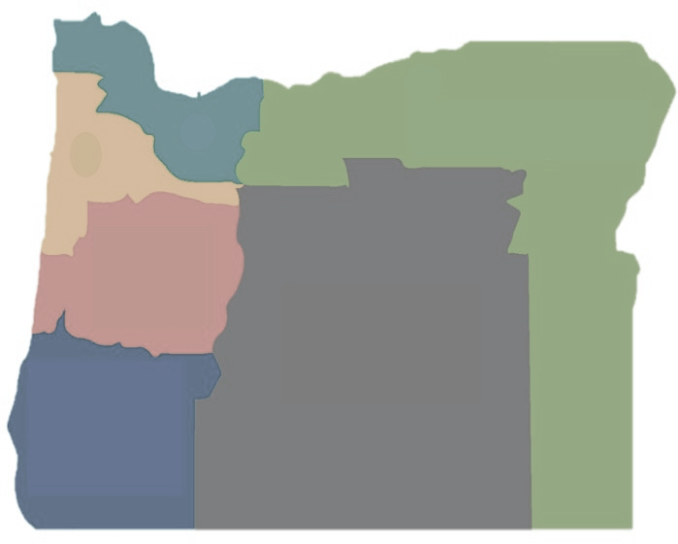
LOCAL ASSOCIATIONS / BOARDS & DISTRICTS
A – Clatsop Association (CAR), Seaside
B – Columbia County Board (CCBR), Portland
C – Portland Metro Association (PMAR), Portland
D – East Metro Association (EMAR), Gresham
E – Mid-Columbia Association (MCAR), Hood River
F – Columbia Basin Board (CBBR), Hermiston
G – Umatilla County Board (UCBR), Pendleton
H – Northeast Oregon Board (NEOBR), LaGrande
I – Four Rivers Association, Nampa, Id.
J – Tillamook County Board (TBOR), Tillamook
K – Yamhill County Association (YCAR), McMinnville
L – Lincoln County Board (LCBR), Lincoln City
M – Polk County Association (PCAR), Rickreall
N – Salem Association (SAR), Salem
O – North Willamette Association (NWAR), Salem
P – Willamette Association (WAOR), Albany
Q – Central Oregon Coast Board (COCBR), Florence
R – Eugene Association (EAR), Eugene
S – Springfield Board (SBOR), Springfield
T – Central Oregon Association (COAR), Bend
U – Coos County Board (CCBOR), North Bend
V – Douglas County Association (DCAR), Roseburg
W – Curry County Board (CCBR), Brookings
X – Rogue Valley Association (RVAR), Medford
Y – Klamath County Association (KCAR), Klamath Falls
Oregon Association (OAR), Salem
Districts (6)
A
1
F
B
E
G
J
C
D
H
2
K
L
N
O
M
6
P
3
Q
R
S
T
I
U
5
V
4
16,500+ Members
X
W
Y
Notes:
Notes/Talking Points
Strength in numbers!
More than 900 new members added in 2017!

