Slide 1
Electronic Resources

Slide 2
Hi Resolution Logo

Slide 3
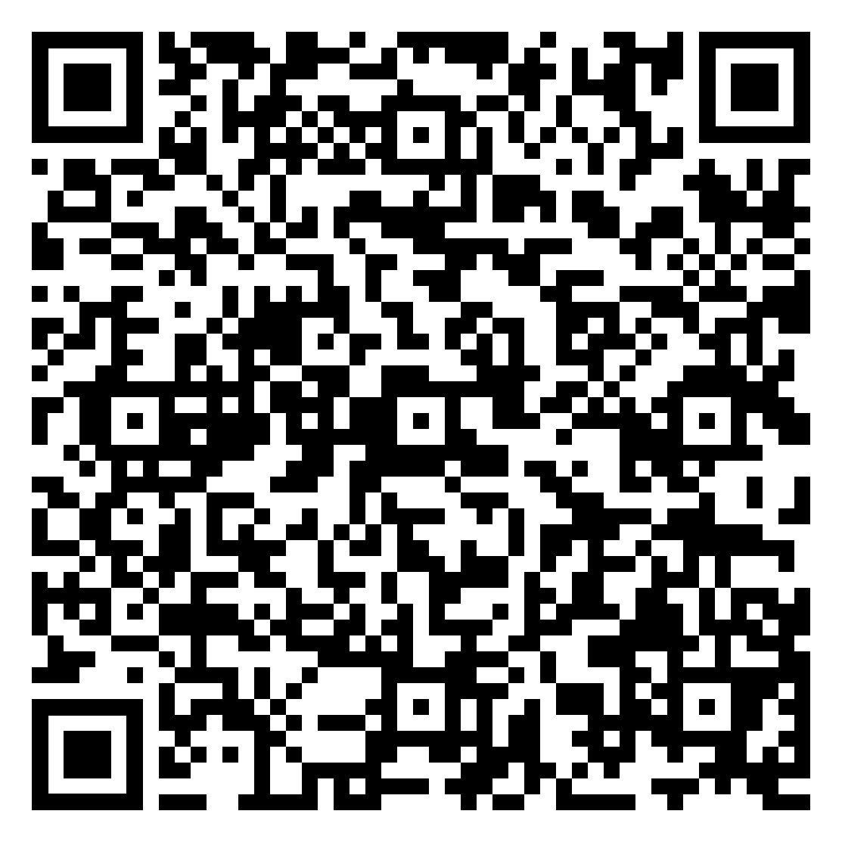
Campaign QR Code

Slide 4
Template Social Media Posts
click here

Slide 5
Lobby/Break Room PowerPoint Slide
available on next slide

Slide 6
Learn more at NOonMeasure118.com

